Slide 1

Large Scale Data Driven Applications
Overview on SQL and RDBMS

Slide 2
Outline
The SFW query (Select From Where)
Other useful operators: LIKE, DISTINCT, ORDER BY
Foreign key constraints
Joins: basics
Joins: SQL semantics
Aggregation & GROUP BY

Slide 3
Introduction to SQL
Structured Query Language (SQL) is the standard language used to perform operations on databases
This language can also be used to create a database
SQL commands are instructions used to interact with a database, perform operations, and execute specific tasks or queries
SQL Commands are mainly categorised into five categories:
DDL – Data Definition Language
DQL – Data Query Language
DML – Data Manipulation Language
DCL – Data Control Language
TCL – Transaction Control Language

Slide 4
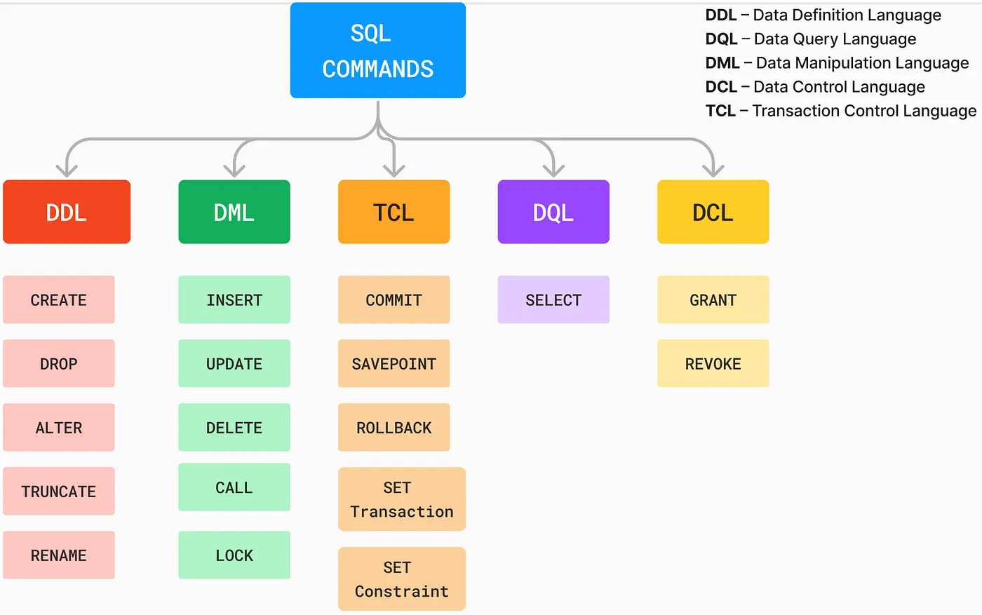
Introduction to SQL
Source: https://medium.com/@reetesh043/different-types-of-sql-commands-2acc78318c61

Slide 5
SQL DDL Commands
Command | Description
CREATE TABLE | Create a table and its columns together with their datatype
ALTER TABLE | Modify column names and add or delete a column
RENAME TABLE | Rename an existing table
DROP TABLE | Delete the table with its data
TRUNCATE TABLE | Remove data from a table without deleting the table
CREATE INDEX | Creates an index for a table
DROP INDEX | Permanently deletes an index
CREATE VIEW | Creates a dynamic subset of rows/columns from one or more tables
DROP VIEW | Permanently deletes a view

Slide 6
SQL DQL and DML Commands
Command | Description
INSERT | Inserts row(s) into a table
SELECT | Selects attributes from rows in one or more tables or views
WHERE | Restricts the selection of rows based on a conditional expression
GROUP BY | Groups the selected rows based on one or more attributes
HAVING | Restricts the selection of grouped rows based on a condition
ORDER BY | Orders the selected rows based on one or more attributes
UPDATE | Modifies attribute’s values in one or more table’s rows
DELETE | Delete one or more rows from a table
CALL | Executes a pre-defined SQL function or a routine
LOCK | Applies a lock to a table to restrict other users from accessing it in a specific way

Slide 7
SQL Operators and Functions
Command or Option | Description
COMPARISON OPERATORS
=, <, >, <=, >=,<> | Used in conditional expressions
LOGICAL OPERATORS
AND/OR/NOT | Used in conditional expressions
SPECIAL OPERATORS
BETWEEN | Checks whether an attribute value is within a range
IS NULL | Checks whether an attribute value is null
LIKE | Checks whether an attribute value matches a given string pattern
IN | Checks whether an attribute value matches any value within a value list
EXISTS | Checks whether a subquery returns any rows
DISTINCT | Limits values to unique values

Slide 8
SQL Operators and Functions
Command or Option | Description
AGGREGATE FUNCTIONS | Used with SELECT to return mathematical summaries on columns
COUNT | Returns the number of rows with non-null values for a given column
MIN | Returns the minimum attribute value found in a given column
MAX | Returns the maximum attribute value found in a given column
SUM | Returns the sum of all values for a given column
AVG | Returns the average of all values for a given column

Slide 9
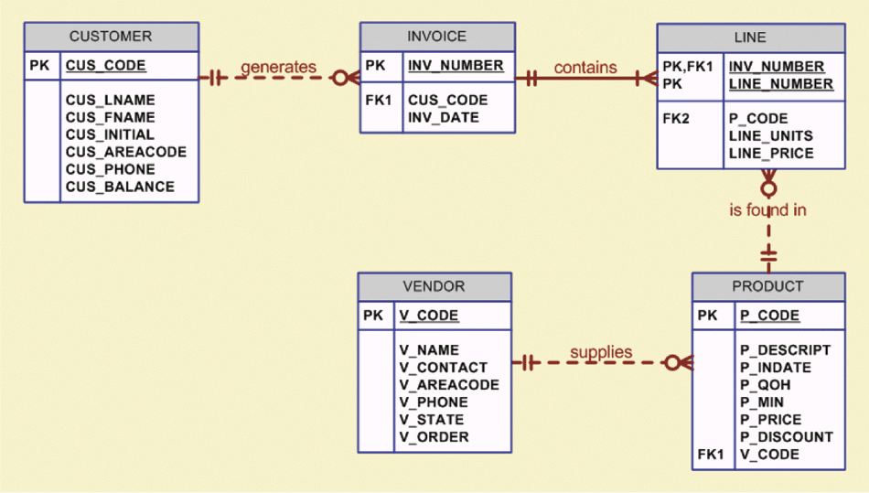
The Database Model

Slide 10
Single-table queries
SQL Query
SELECT
Used to list contents of table
Basic Syntax form
SELECT <attributes> FROM <one or more relations> WHERE <conditions>
Call this a SFW query.

Slide 11
Simple SQL Query: Selection
Product
PName | Price | Category | Manufacturer
Gizmo | £19.99 | Gadgets | GizmoWorks
Powergizmo | £29.99 | Gadgets | GizmoWorks
SingleTouch | £149.99 | Photography | Canon
MultiTouch | £203.99 | Household | Hitachi
Selection is the operation of filtering a relation’s tuples on some condition
SELECT * FROM Product WHERE Category = ‘Gadgets’
PName | Price | Category | Manufacturer
Gizmo | £19.99 | Gadgets | GizmoWorks
Powergizmo | £29.99 | Gadgets | GizmoWorks

Slide 12
Simple SQL Query: Selection
Product
Projection is the operation of producing an output table with tuples that have a subset of their prior attributes
PName | Price | Category | Manufacturer
Gizmo | £19.99 | Gadgets | GizmoWorks
Powergizmo | £29.99 | Gadgets | GizmoWorks
SingleTouch | £149.99 | Photography | Canon
MultiTouch | £203.99 | Household | Hitachi
SELECT PName, Price, Manufacturer FROM Product WHERE Category = ‘Gadgets’
PName | Price | Manufacturer
Gizmo | £19.99 | GizmoWorks
Powergizmo | £29.99 | GizmoWorks

Slide 13
Notations
Input schema
Product(PName, Price, Category, Manfacturer)
SELECT PName, Price, Manufacturer FROM Product WHERE Category = ‘Gadgets’
Output schema
Answer(PName, Price, Manfacturer)
A Few Details
SQL commands are case insensitive:
Same: SELECT, Select, select
Same: Product, product
Values are not:
Different: ‘Seattle’, ‘seattle’
Use single quotes for constants:
‘abc’ - yes
“abc” - no

Slide 14
LIKE: Simple String Pattern Matching
SQL Data Manipulation Commands (Special Operators)
SELECT * FROM Products WHERE PName LIKE ‘%gizmo%’
s LIKE p: pattern matching on strings
p may contain two special symbols:
% = any sequence of characters
_ = any single character

Slide 15
DISTINCT: Eliminating Duplicates
SQL Data Manipulation Commands (Special Operators)
SELECT DISTINCT Category
FROM Product
Category
Gadgets
Photography
Household
Versus
SELECT Category
FROM Product
Category
Gadgets
Gadgets
Photography
Household

Slide 16
ORDER BY: Sorting the Results
SQL Data Manipulation Commands (Special Operators)
SELECT PName, Price, Manufacturer
FROM Product
WHERE Category=‘gizmo’ AND Price > 50
ORDER BY Price, PName
Ties are broken by the second attribute on the ORDER BY list, etc.
Ordering is ascending, unless you specify the DESC keyword.

Slide 17
Foreign Key constraints
Suppose we have the following schema:
And we want to impose the following constraint:
‘Only students with Visa may enroll in courses’ i.e. a student must appear in the Students table to enroll in a class
Students(sid: string, name: string, gpa: float)
Enrolled(student_id: string, cid: string, grade: string)
Students
Enrolled
sid | name | gpa
101 | Bob | 3.2
123 | Mary | 3.8
student_id | cid | grade
123 | 564 | A
123 | 537 | A+
student_id alone is not a key- what is?
We say that student_id is a foreign key that refers to sid in Students

Slide 18
Declaring Foreign Keys
Students(sid: string, name: string, gpa: float)
Enrolled(student_id: string, cid: string, grade: string)
CREATE TABLE Enrolled(
student_id CHAR(20),
cid CHAR(20),
grade CHAR(10),
PRIMARY KEY (student_id, cid),
FOREIGN KEY (student_id) REFERENCES Students(sid)
)
Foreign Keys and update operations
Students(sid: string, name: string, gpa: float)
Enrolled(student_id: string, cid: string, grade: string)
What if we insert a tuple into Enrolled, but no corresponding student?
INSERT is rejected (foreign keys are constraints)!

Slide 19
Primary Keys and Foreign Keys
Company
CName | StockPrice | Country
GizmoWorks | 25 | USA
Canon | 65 | Japan
Hitachi | 15 | Japan
Can you identify the primary key and foreign key relationship in this context?
Product
PName | Price | Category | Manufacturer
Gizmo | £19.99 | Gadgets | GizmoWorks
Powergizmo | £29.99 | Gadgets | GizmoWorks
SingleTouch | £149.99 | Photography | Canon
MultiTouch | £203.99 | Household | Hitachi

Slide 20
Joins
SQL Data Manipulation Commands (Special Operators)
Product(PName, Price, Category, Manufacturer)
Company(CName, StockPrice, Country)
Company
Ex: Find all products under £200 manufactured in Japan; return their names and prices.
CName | StockPrice | Country
GizmoWorks | 25 | USA
Canon | 65 | Japan
Hitachi | 15 | Japan
SELECT PName, Price FROM Product, Company WHERE Manufacturer = CName
AND Country=‘Japan’ AND Price <= 200
Product
PName | Price | Category | Manufacturer
Gizmo | £19.99 | Gadgets | GizmoWorks
Powergizmo | £29.99 | Gadgets | GizmoWorks
SingleTouch | £149.99 | Photography | Canon
MultiTouch | £203.99 | Household | Hitachi

Slide 21
Joins
SQL Data Manipulation Commands (Special Operators)
Product(PName, Price, Category, Manufacturer)
Company(CName, StockPrice, Country)
Ex: Find all products under £200 manufactured in Japan; return their names and prices.
SELECT PName, Price FROM Product, Company WHERE Manufacturer = CName
AND Country=‘Japan’ AND Price <= 200
A join between tables returns all unique combinations of their tuples which meet some specified join condition

Slide 22
Joins
SQL Data Manipulation Commands (Special Operators)
Product(PName, Price, Category, Manufacturer)
Company(CName, StockPrice, Country)
Ex: Find all products under £200 manufactured in Japan; return their names and prices.
Several equivalent ways to write a basic join in SQL:
SELECT PName, Price FROM Product, Company WHERE Manufacturer = CName
AND Country=‘Japan’ AND Price <= 200
SELECT PName, Price FROM Product
JOIN Company ON Manufacturer = CName
AND Country=‘Japan’ WHERE Price <= 200

Slide 23
Joins
SQL Data Manipulation Commands (Special Operators)
Product
PName | Price | Category | Manufacturer
Gizmo | £19 | Gadgets | GWorks
Powergizmo | £29 | Gadgets | GWorks
SingleTouch | £149 | Photography | Canon
MultiTouch | £203 | Household | Hitachi
Company
CName | Stock | Country
GWorks | 25 | USA
Canon | 65 | Japan
Hitachi | 15 | Japan
SELECT PName, Price FROM Product
JOIN Company ON Manufacturer = CName
AND Country=‘Japan’ WHERE Price <= 200
PName | Price
SingleTouch | £149.99

Slide 24
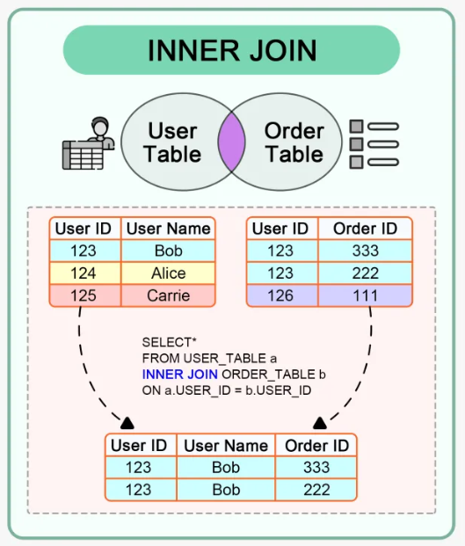
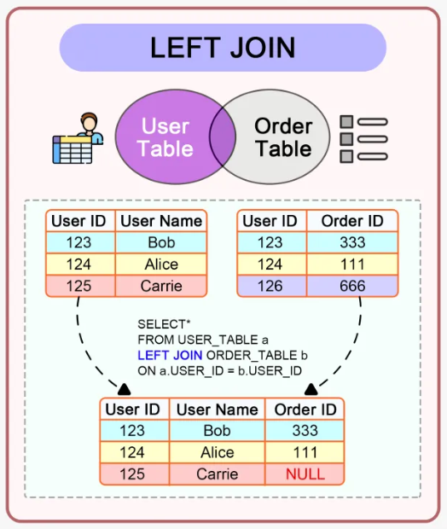
Joins: Types
SQL Data Manipulation Commands (Special Operators)
INNER JOIN: Returns records that have matching values in both tables
LEFT JOIN: Returns all records from the left table, and the matched records from the right table
Image source: https://blog.bytebytego.com/p/ep90-how-do-sql-joins-work

Slide 25
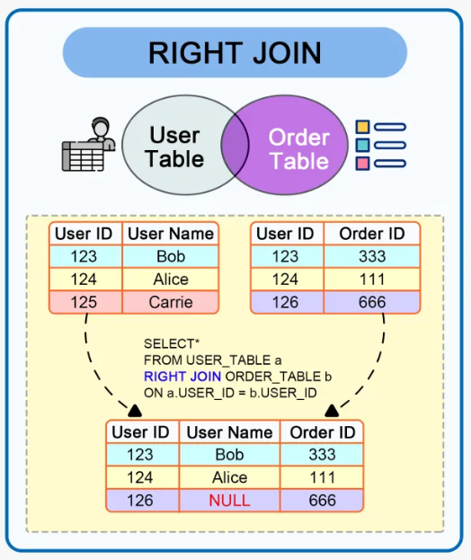
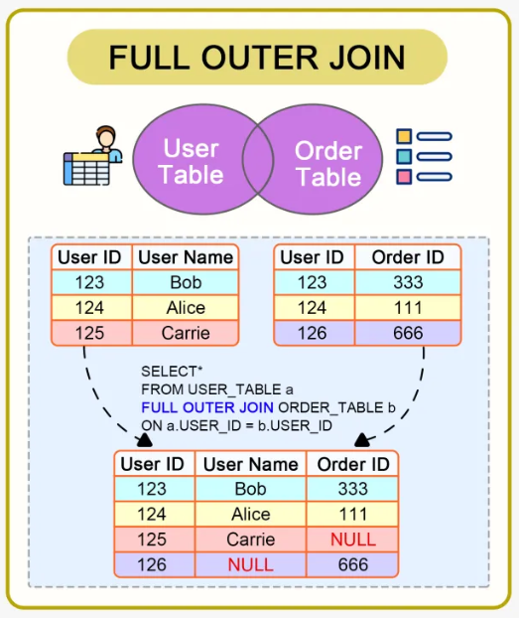
Joins: Types
SQL Data Manipulation Commands (Special Operators)
RIGHT JOIN: Returns all records from the right table, and the matched records from the left table
FULL (OUTER) JOIN: Returns all records when there is a match in either left or right table
Image source: https://blog.bytebytego.com/p/ep90-how-do-sql-joins-work

Slide 26
Aggregate Functions
SQL Data Manipulation Commands
Command or Option | Description
AGGREGATE FUNCTIONS | Used with SELECT to return mathematical summaries on columns
COUNT | Returns the number of rows with non-null values for a given column
MIN | Returns the minimum attribute value found in a given column
MAX | Returns the maximum attribute value found in a given column
SUM | Returns the sum of all values for a given column
AVG | Returns the average of all values for a given column

Slide 27
Aggregation Functions
SQL Data Manipulation Commands
SELECT AVG(price)
FROM Product
WHERE maker = “Toyota”
SELECT COUNT(*)
FROM Product
WHERE year > 1995
SQL supports several aggregation operations:
SUM, COUNT, MIN, MAX, AVG
Except COUNT, all aggregations apply to a single attribute

Slide 28
Aggregate: COUNT
SQL Data Manipulation Commands
COUNT applies to duplicates, unless otherwise stated
SELECT COUNT(category)
FROM Product
WHERE year > 1995
Note: Same as COUNT(*). Why?
We probably want:
SELECT COUNT(DISTINCT category)
FROM Product
WHERE year > 1995

Slide 29
SQL Data Manipulation Commands
Grouping and Aggregation
Purchase(product, date, price, quantity)
SELECT product,
SUM(price * quantity) AS TotalSales
FROM Purchase
WHERE date > ‘10/1/2005’
GROUP BY product
Find total sales after 10/1/2005 per product.
Let’s see what this means…

Slide 30
Grouping and Aggregation
SQL Data Manipulation Commands
SELECT product,
SUM(price * quantity) AS TotalSales
FROM Purchase
WHERE date > ‘10/1/2005’
GROUP BY product
Semantics of the query:
1. Compute the FROM and WHERE clauses
2. Group by the attributes in the GROUP BY
3. Compute the SELECT clause: grouped attributes and aggregates

Slide 31
SQL Data Manipulation Commands
Compute the FROM and WHERE clauses
SELECT product,
SUM(price * quantity) AS TotalSales
FROM Purchase
WHERE date > ‘10/1/2005’
GROUP BY product
Product | Date | Price | Quantity
Bagel | 10/21 | 1 | 20
Bagel | 10/25 | 1.50 | 20
Banana | 10/3 | 0.5 | 10
Banana | 10/10 | 1 | 10
FROM

Slide 32
SQL Data Manipulation Commands
Group by the attributes in the GROUP BY
SELECT product,
SUM(price * quantity) AS TotalSales
FROM Purchase
WHERE date > ‘10/1/2005’
GROUP BY product
Product | Date | Price | Quantity
Bagel | 10/21 | 1 | 20
Bagel | 10/25 | 1.50 | 20
Banana | 10/3 | 0.5 | 10
Banana | 10/10 | 1 | 10
GROUP BY
Product | Date | Price | Quantity
Bagel | 10/21 | 1 | 20
 | 10/25 | 1.50 | 20
Banana | 10/3 | 0.5 | 10
 | 10/10 | 1 | 10

Slide 33
SQL Data Manipulation Commands
Compute the SELECT clause: grouped attributes and aggregates
SELECT product,
SUM(price * quantity) AS TotalSales
FROM Purchase
WHERE date > ‘10/1/2005’
GROUP BY product
Product | Date | Price | Quantity
Bagel | 10/21 | 1 | 20
 | 10/25 | 1.50 | 20
Banana | 10/3 | 0.5 | 10
 | 10/10 | 1 | 10
Product | TotalSales
Bagel | 50
Banana | 15
SELECT

Slide 34
SQL Data Manipulation Commands
HAVING Clause
SELECT product, SUM(price*quantity)
FROM Purchase
WHERE date > ‘10/1/2005’
GROUP BY product
HAVING SUM(quantity) > 100
Same query as before, except that we consider only products that have more than
100 buyers
HAVING clauses contains conditions on aggregates
Whereas WHERE clauses condition on individual tuples…

Slide 35
SQL Data Manipulation Commands
Group-by vs Nested Query
Author(login, name)
Wrote(login, url)
Find authors who wrote ≥ 10 documents:
Attempt 1: with nested queries
SELECT DISTINCT Author.name
FROM Author
WHERE COUNT(
SELECT Wrote.url FROM Wrote WHERE Author.login = Wrote.login) > 10
This is SQL by a novice

Slide 36
SQL Data Manipulation Commands
Group-by vs Nested Query
Author(login, name)
Wrote(login, url)
Find all authors who wrote at least 10 documents:
Attempt 2: SQL style (with GROUP BY)
SELECT Author.name
FROM Author, Wrote
WHERE Author.login = Wrote.login
GROUP BY Author.name
HAVING COUNT(Wrote.url) > 10
This is SQL by an expert
No need for DISTINCT: automatically from GROUP BY
With GROUP BY can be much more efficient!

Slide 37
Questions?

